Slide 1
Healthcare for asylum seekers
Introduction to the Swedish Healthcare system
March 2016
Finns även tillgänglig digitalt på www.uppdragpsykiskhalsa.se

Slide 2

Aim with today’s presentation
  Give an introduction to Swedish healthcare
  Inform about asylum seekers’ rights to healthcare
  Invite to participate in Health Check-up
  Today will not allow for personal questions or consultation about medical problems

Slide 3

Introduction film

Slide 4
Agenda for today’s presentation
  General principles of Swedish healthcare
  Asylum seekers’ rights to healthcare
  Health check-up
  Self care and 1177-information services
  Swedish Healthcare system
    Local healthcare centers
    Hospitals
    Other services (including dental care)

Slide 5
Agenda for today’s presentation
  General principles of Swedish healthcare
  Asylum seekers’ rights to healthcare
  Health check-up
  Self care and 1177-information services
  Swedish Healthcare system
    Local healthcare centers
    Hospitals
    Other services (including dental care)

Slide 6
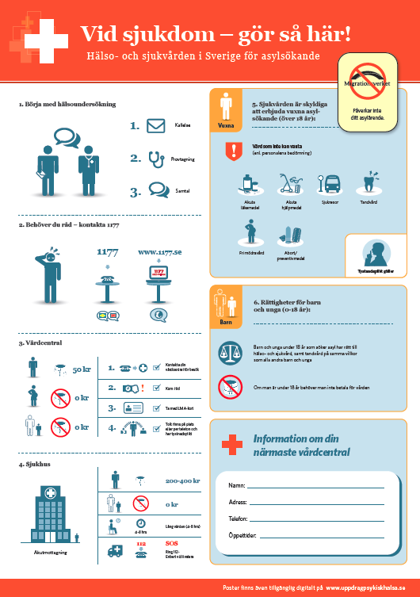
There are some things that are unique about the Swedish healthcare system including roles and principles
  Nurses have a very important role and are highly educated
  Keeping time is essential – otherwise other patients will go first
  Visit your healthcare center before a hospital*
  Nurses and doctors have sworn an oath of confidentiality
  If you don’t understand Swedish you are entitled to an interpreter (also sworn oath of confidentiality)
  Access to antibiotics is restricted to stop MRSA
* Unless life-threatening – then call 112

Slide 7
Agenda for today’s presentation
  General principles of Swedish healthcare
  Asylum seekers’ rights to healthcare
  Health check-up
  Self care and 1177-information services
  Swedish Healthcare system
    Local healthcare centers
    Hospitals
    Other services (including dental care)

Slide 8













Regions must offer care that cannot wait to adult asylum seekers
Regional responsibilities for adult asylum seekers over 18 years old
Regions must offer care that cannot wait (as determined by medical staff) including:
Medicines that cannot wait
Basic medical aids
Access/transportation to care
Care during pregnancy
Abortion and contraception
Adults
Right to privacy – all medical staff has sworn an oath of confidentiality
Notes:
Viktigt att informera om lokala tolkningar vad som inkluderas i stöd som erbjuds avseende bl.a. transport och hjälpmedel

Slide 9



Regions must offer asylum seeking children the same level of care as Swedish children
Regional responsibilities for children asylum seekers under 18 years old
Children and teenagers are to receive health and dental care on the same terms as children/teenagers living in Sweden.
There are no costs for care related to childrens health and dental care
Children

Slide 10
Agenda for today’s presentation
  General principles of Swedish healthcare
  Asylum seekers’ rights to healthcare
  Health check-up
  Self care and 1177-information services
  Swedish Healthcare system
    Local healthcare centers
    Hospitals
    Other services (including dental care)

Slide 11
Health check-up is the starting point to access Swedish healthcare
Arrival to Sweden
Health check-up
1177 –for self care advice
Local healthcare centers
(Primary care)
Hospitals
(Secondary care)

Slide 12







You will receive a letter when it is your turn, and it is very important to come on time
Step 1 – Receive letter
Step 2 – Health check up
Step 3 – Contact if needed
Referral to doctor – only if needed
Blood test and physical check-up
No information is passed on to Migrations-verket
Conversation with a specialist nurse
Time and place
Further aid available after residence permit
Bring your LMA-card
No costs

Slide 13
Health check-up is free and does not affect your asylum process – it is for your health only
  Health-check ups are free
  You will receive a letter when it is your turn
  (children and families are prioritized)
  It is very important to come on time – otherwise no interpreter/no meeting
  If sick today, then please contact your local healthcare center
  Special nurses are responsible for health check up and includes a conversation about your medical history and your medical needs
  Check-up also includes blood tests
  Referral to doctor is only done if necessary for further investigation
  You have the right to an interpreter if you do not understand Swedish – they have also sworn an oath of confidentiality
  The Swedish Migration Agency will not be given the results of the health check-up. The results of the health examination will not affect your ability to stay in Sweden.

Slide 14
If you have medical problems there is a lot of self care advice on 1177 – they can also direct you where to go
Arrival to Sweden
Health check-up
1177 –for self care advice
Local healthcare centers
(Primary care)
Hospitals
(Secondary care)

Slide 15
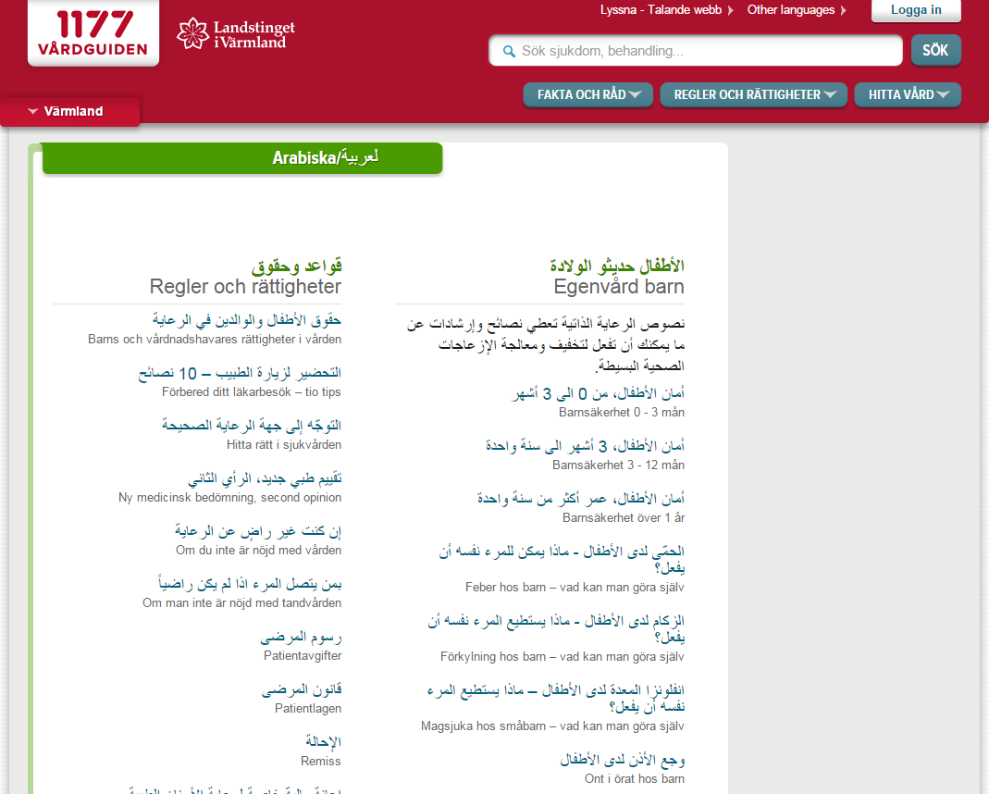
Self-help and information channels are available 24/7 with basic advice and channel for questions
1177.Se - Website with healthcare information in your language
  Telephone 1177
    Twenty-four hours a day
    For healthcare advice and for information about clinics to contact about your particular needs
    Nurses speaks swedish and english
  Website www.1177.se
    Advice on diseases and information about the Swedish healthcare system
    Under “Other Languages” you will find advice in multiple languages
www.1177.se

Slide 16
Local healthcare centers is the first place to go for help
Arrival to Sweden
Health check-up
1177 –for self care advice
Local healthcare centers
(Primary care)
Hospitals
(Secondary care)

Slide 17

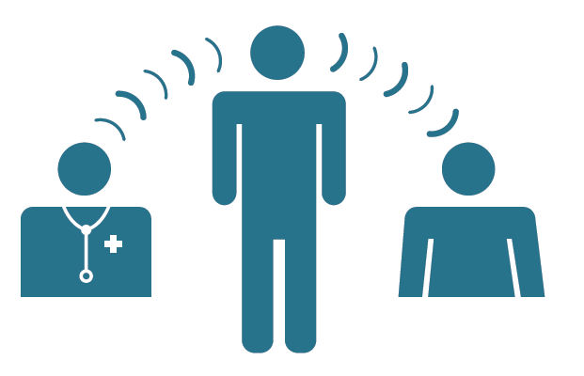

Your local healthcare center – primary choice when in need of medical assistance
  The local healthcare centre is the primary choice if you are in need of medical assistance
  If you do not understand swedish you are entitled to an intepreter (who has sworn an oath of confidentiality)
  Contact your local healthcare center to make an appointment – some have Walk-in Clinics
  It is important to be on time and not to be late
  Bring your LMA-card with you

Slide 18
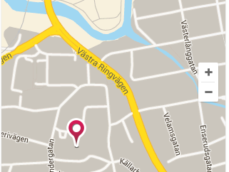
Information about your local healthcare center
LÄGG IN LOKAL INFORMATION
Name
[Lägg till namn på Vårdcentralen]
Adress
[Lägg till adress här]
Phone
[Lägg till telefonnummer]
[Lägg till öppettider för telefon]

Slide 19
Hospitals–
For acute care and conditions that require a subspecialty
Arrival to Sweden
Health check-up
1177 –for self care advice
Local healthcare centers
(Primary care)
Hospitals
(Secondary care)

Slide 20




Hospitals–
For acute care and conditions that require a subspecialty
  If you have a severe illness or acute injury please go to the emergency clinic at the hospital
  If you are not in acute need, the wait might be long,
  up to 8 hrs
  Hospital visits cost multiple times more than local healthcare center
  In a life-threatening situation - please call 112 for
  Police, Fire department and Ambulance
  Swedish ambulances are advanced medical units

Slide 21
Cost for healthcare services is limited for adults during asylum process and free for children
Cost for healthcare
Children (under 18 years): free
Healthcare center for adults: doctor 50 kr
nurse 25 kr
Hospital/ambulance* visit 200 kr
Care for pregnant women free
Counselling, abortion free
Childbirth free
* Cost for ambulance/ER-visits may vary depending on regional authority

Slide 22
Agenda for today’s presentation
  General principles of Swedish healthcare
  Asylum seekers’ rights to healthcare
  Health check-up
  Self care and 1177-information services
  Swedish Healthcare system
    Local healthcare centers
    Hospitals
    Other services (including dental care)

Slide 23






Other important services such as dental care and pharmacies can be accessed as well
Dental care
  Free for children under 18 years old
  Adults have the right to care that cannot wait, for example trauma and loosing teeth
Pharmacy
  Supplies medicine and other medical products
  Drugs prescribed by doctors can be paid and collected
    Prescribed medicine 50 kr
    Non-prescribed medicine Full price
      E.g. nose spray, pain killers
Eye glasses
  Please contact Migrationsverket for a referral to an optician

Slide 24

Questions
Finns även tillgänglig digitalt på www.uppdragpsykiskhalsa.se

